Slide 1
Pet dental insights & Trends in our market
Eduardo Beato

Slide 2
Who are we?
Pet Dental is a pet consumables dental brand
We are looking to understand:
how our products are performing in specific markets
what growth/changes have occurred over the last few periods

Slide 3
Our goals
Develop a detailed, meaningful analysis of this data to provide a pet dental brand insights into their market over time
Identify trends in the data that the brand should be paying attention to in comparison to their competitors

Slide 4
The Data

Slide 5
Data Structure
The data is grouped by quarters
The following quarters are included in the data set:
Quarter - W/E 12-30-2023
Quarter - W/E 09-30-2023
Quarter - W/E 07-01-2023
Quarter - W/E 04-01-2023
Custom 13 Week - W/E 02-03-2024
Custom 13 Week - W/E 11-04-2023
Custom 13 Week - W/E 08-05-2023
Custom 13 Week - W/E 05-06-2023
Custom 4 Week - W/E 02-03-2024
The data includes YA columns, which means we also have data from 2022
76,268 entries
62 columns
Many qualitative and quantitative types of data for each entry
Categorical, descriptive, financial, time, count, etc.

Slide 6
Data Preparation
Cleaning the data
Duplicates
5 duplicates were found and removed
Missing Values
There was a total of 366,676 blank cells
Normally I would speak to my supervisor about how to handle this data, but in this case I did not remove them
Adding several key columns
Time Periods
I extracted the date from the quarter descriptions to use in my analysis
Market Share
YoY Growth Total $ Sales
YoY Growth Total Unit Sales
YoY Growth $ / $MM ACV (Max)
YoY Growth Units / $MM ACV (Max)

Slide 7
Sales overview

Slide 8
Highlights
Total revenue = $2.78 Billion 0.3% $8 Mill
Total unit sales = 278 Million 5.6% 16.5 Mill
Notable increases/decreases this year
Greater Wild (Marlin Trading LLC) 39,288% $167K
Zoe (Rolf C. Hagen INC) 28,517% $132K
Organic Items 96.2% $600K
Weight Control 53.4% $2 Mill
Grain Free 10.2% $45 Mill
Derm/Skin 18.9% $17 Mill
Petsmart Ecom Total 35.1% $6 Mill

Slide 9
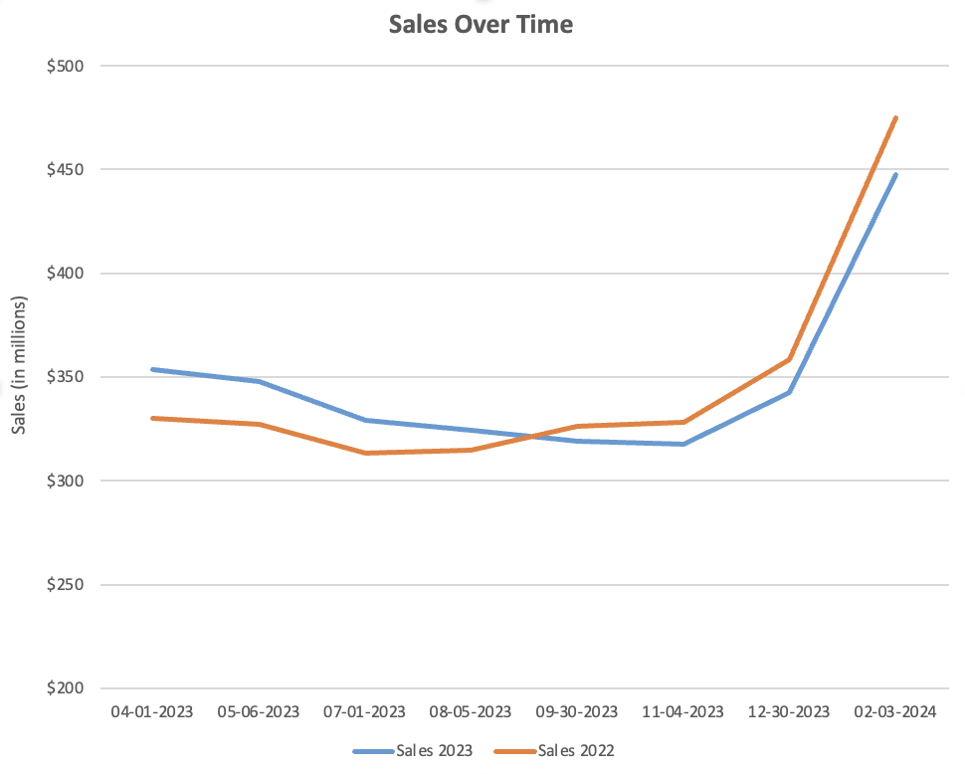
Sales over time
Both years follow similar trends
Consistent from April – November
Peak from December – February
The YoY growth starts high but steadily decreases
Early 2023 the YoY growth is positive
After the summer the YoY growth becomes negative

Slide 10
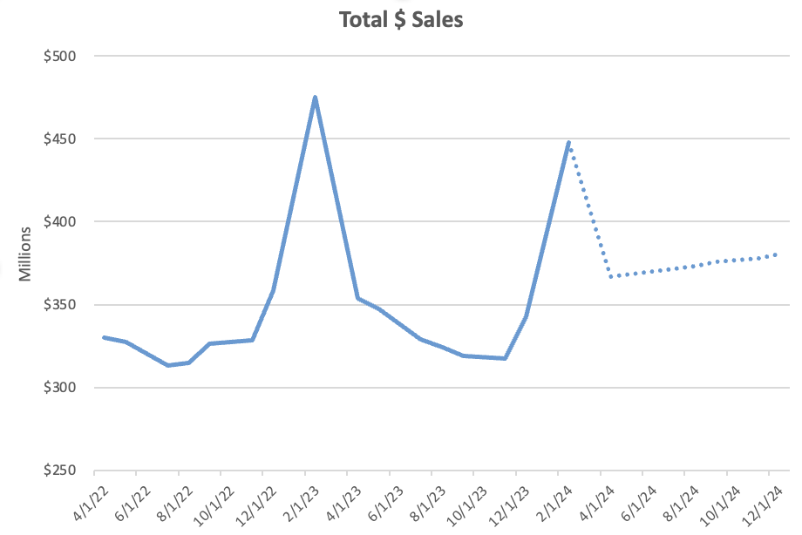
Forecasted total revenue
GREAT NEWS!
Exponential smoothing projects us to have positive YoY growth through December 2024

Slide 11
Product performance

Slide 12
Total revenue
Top 5
Bottom 5
1.) GREENIES (THE NUTRO COMPANY) $584 M
2.) EARTH ANIMAL (JDN INC) $374 M
3.) WHIMZEES (WELLNESS PET COMPANY) $329 M
4.) FIELDCREST FARMS (ETHICAL PRODUCTS INC) $246 M
5.) MILK-BONE (BIG HEART PET BRANDS) $125 M
1.) PURINA (NESTLE PURINA PET CARE COMPANY) $4
2.) HILL'S SCIENCE DIET (HILL'S PET NUTRITION, INC.) $14
3.) BILLY + MARGOT (REAL PET FOOD COMPANY) $15
4.) BRIGHT BITES (SUGAR CREEK PET PRODUCTS LLC) $16
5.) BEEFEATERS (PETRAPPORT INC.) $54

Slide 13
Yoy growth Total revenue
Top 5
Bottom 5
1.) GREATER WILD (MARLIN TRADING LLC) 39,288%
2.) ZOE (ROLF C. HAGEN INC.) 28,517%
3.) THE NEW ZEALAND NATURAL PET FOOD CO (THE NEW ZEALAND NATURAL PET FOOD CO) 873%
4.)WHOLISTIC PET ORGANICS (WHOLISTIC PET ORGANICS)
748%
5.) WALK ABOUT (WALK ABOUT TREATS) 691%
1.) PURINA (NESTLE PURINA PET CARE COMPANY) 100%
2.) CANINE CHEWS (MUNOZ MAGANA S.A. DE C.V.) 100%
3.) MEATY BONE (BIG HEART PET BRANDS) 100%
4.) PRIMAL (PRIMAL PET FOODS INC) 99%
5.) SNACK STATION (THINS AND THAT CANINE COMPANY INC)
99%

Slide 14
Average Revenue per $Million ACV
Top 5
Bottom 5
1.) GREATER WILD (MARLIN TRADING LLC) $447,726
2.) ORA VET (MERIAL LIMITED) $226,060
3.) PET LIFE (SUNSHINE MILLS INC) $6,224
4.) DURKHA (DURKHA DOG CHEW) $5,982
5.) PET PLANET (WORLDWISE INC) $5,929
1.) MOE'S HEALTHY PETS (PKM PET LLC) $4
2.) JINX (JINX INC) $5
3.) LUV CHEW (GOODDYZ LLC) $5
4.) VETALITY (TEVRA BRANDS) $6
5.) CHEW + HEAL (CLICK INDUSTRIES LLC) $10

Slide 15
YOY Growth revenue per $Million ACV
Top 5
Bottom 5
1.) WHOLISTIC PET ORGANICS (WHOLISTIC PET ORGANICS)
4735%
2.) THE NEW ZEALAND NATURAL PET FOOD CO (THE NEW ZEALAND NATURAL PET FOOD CO)
3603%
3.) KOOWILL V UNITED (KOOWILL INC) 808%
4.) BUTCHER'S BONES (S&S PRODUCTS, INC.) 761%
5.) ORA VET (MERIAL LIMITED) 656%
1.) ZOE (ROLF C. HAGEN INC.) 95%
2.) JW (J.W. PET COMPANY INC) 93%
3.) PURINA (NESTLE PURINA PET CARE COMPANY) 92%
4.) CANINE CHEWS (MUNOZ MAGANA S.A. DE C.V.) 90%
5.) BEST BUY BONES (BEST BUY BONES) 80%

Slide 16
Distribution analysis

Slide 17
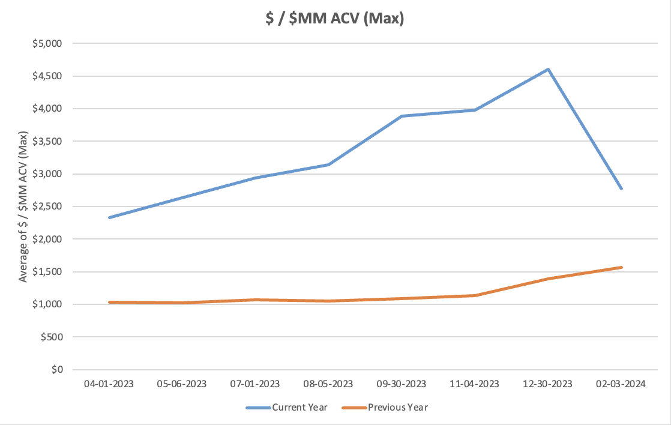
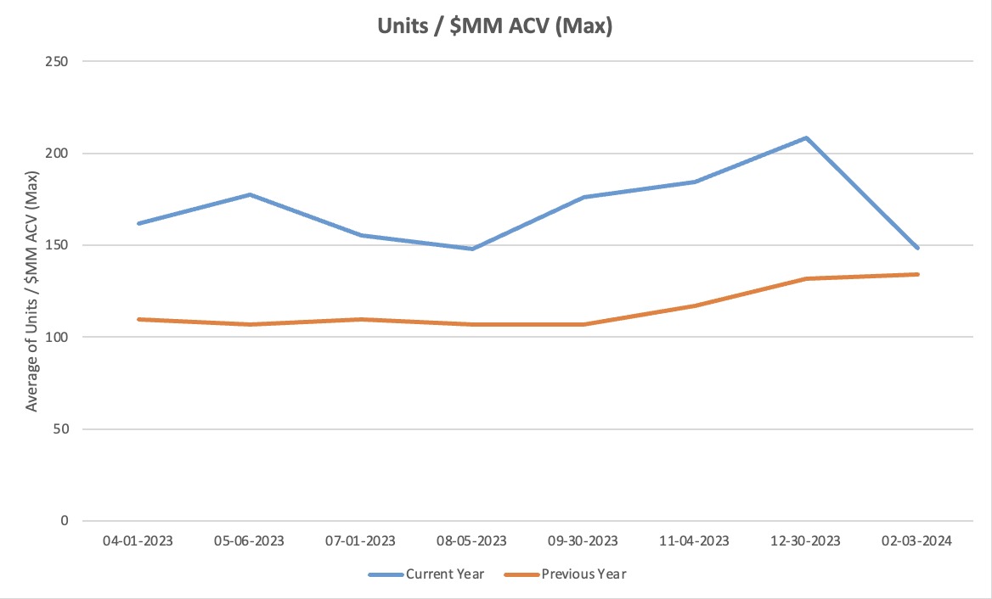
Sales per $million acv
Both revenue and unit sales per $Million ACV increased in 2023
Our sales efficiency relative to distribution has improved
This could be because of better targeting, improved product performance, or strategic distribution adjustments
After the holiday season sales per $Million ACV drops significantly
It is still higher than that of 2022, but it’s trending in the opposite direction

Slide 18
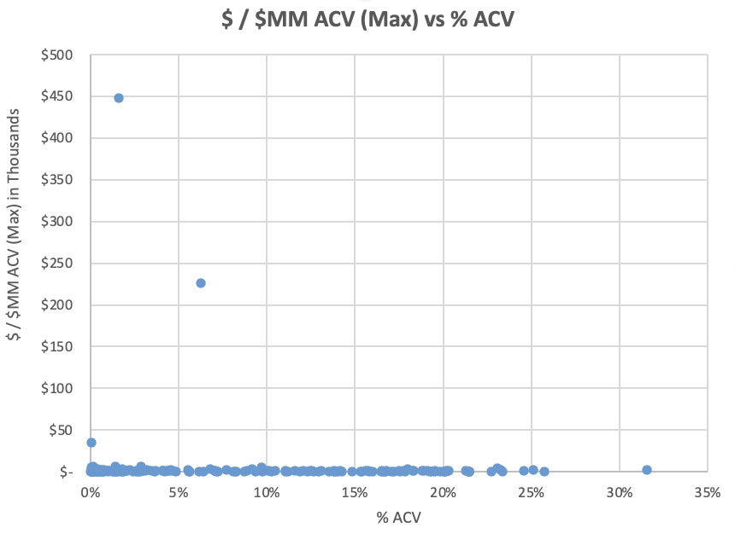
Sales per $million acv vs % acv
Two products stand out here because they have the highest sales per $million ACV but they’re % ACV is low
Greater Wild (Marlin Trading LLC)
Ora Vet (Merial Limited)
They are performing well even with limited distribution.
They may benefit from greater distribution
The bottom 6 products in sales per $million ACV all rank in the top 12 in %ACV
These products have good distribution, but are not generating proportional sales
Alpha Paw Chew + Heal
Vetality Luv Chew
Jinx Moe’s Healthy Pets

Slide 19
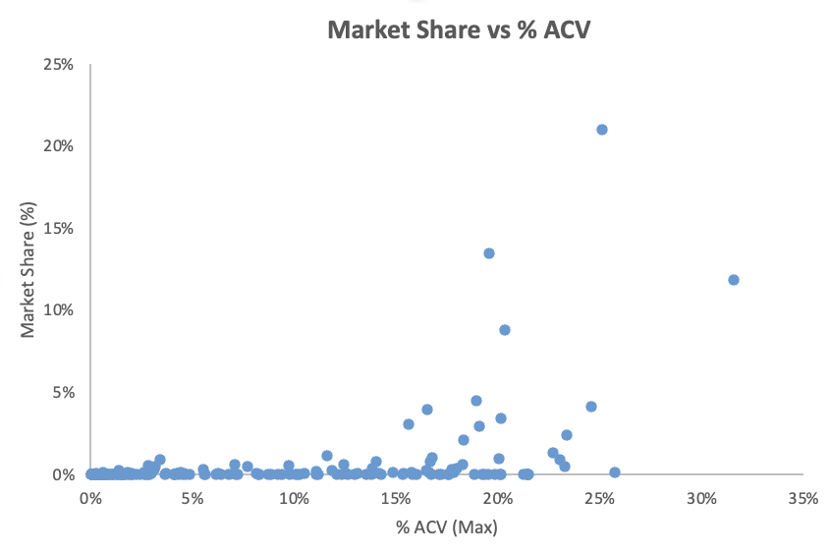
Market share vs % acv
Market share begins to rise significantly after 15 % ACV
There aren’t any high market share products with low ACV
This shows us that our distribution strategies are effective
Arm & Hammer (Fetch… For Pets!) has the second highest % ACV at 25.72%, yet it’s market share is very low
This product may have room for growth in terms of sales

Slide 20
conclusions

Slide 21
Total revenue increased this year!
In the second half of the year our total revenue decreased in comparison to the previous year
This could be caused by many different factors such as economic downturn, increased competition, pricing strategies, marketing, etc.
We will have to dig deeper to ensure that this trend does not continue!
But…

Slide 22
Impressive growth in sales efficiency
Whether this is due to better targeting, improved product performance, or strategic distribution adjustments, we made great strides this year
Let’s find out exactly what led to these improvements and keep executing them to keep this trend upwards

Slide 23
Strong products
Zoe (Rolf C. Hagen INC.) has become one of the most efficient products
Greater Wild and Ora Vet are performing very well, despite limited distribution
Let’s think about getting them greater distribution

Slide 24
In need of improvements
We have a handful of products that have very high % ACV but do no generate proportional sales
It is worth looking into strategies to improve the sales on some of these items that already have great distribution
Specifically Arm & Hammer had the second highest %ACV
It did see a YoY growth of 178% in total revenue, so there is potential for this to continue to grow

